Slide 1


SAP UI5 & FIORI with OData TRAINING using BAS
Anubhav Oberoy
Day – 10

Slide 2

Agenda – Day 10
Introduction to List controls in SAP UI5
Types of List in UI5
Creating model in Manifest.json
Search Functionality
List Modes and Grouping

Slide 3
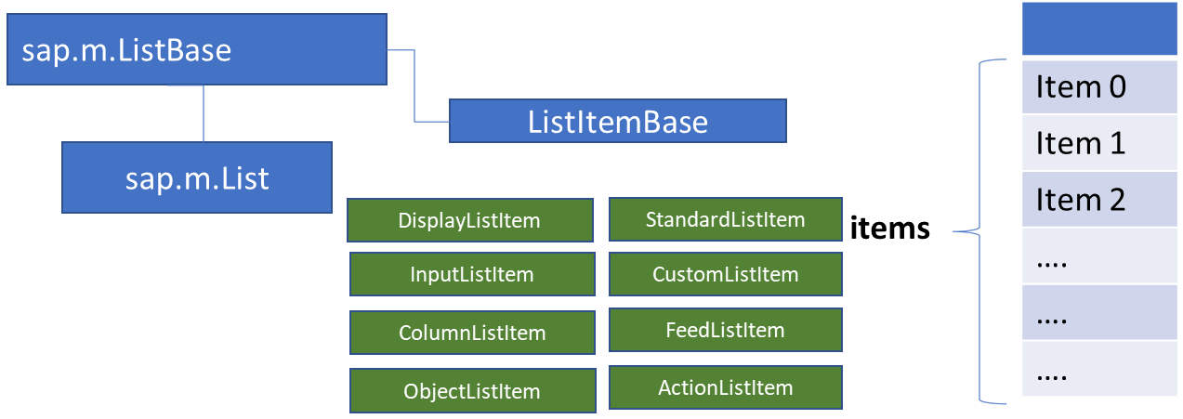
List Control
The list contains various list items. These items can be of various types depending on the use case and on the content they have. SAPUI5 already provides the most common list items in SAP Fiori in the form of controls, although custom list items can also be created if necessary.
Reference: https://sapui5.hana.ondemand.com/#/entity/sap.m.List
A List control is a single column table with multiple items inside. We will have a list header and items as aggregation.

Slide 4
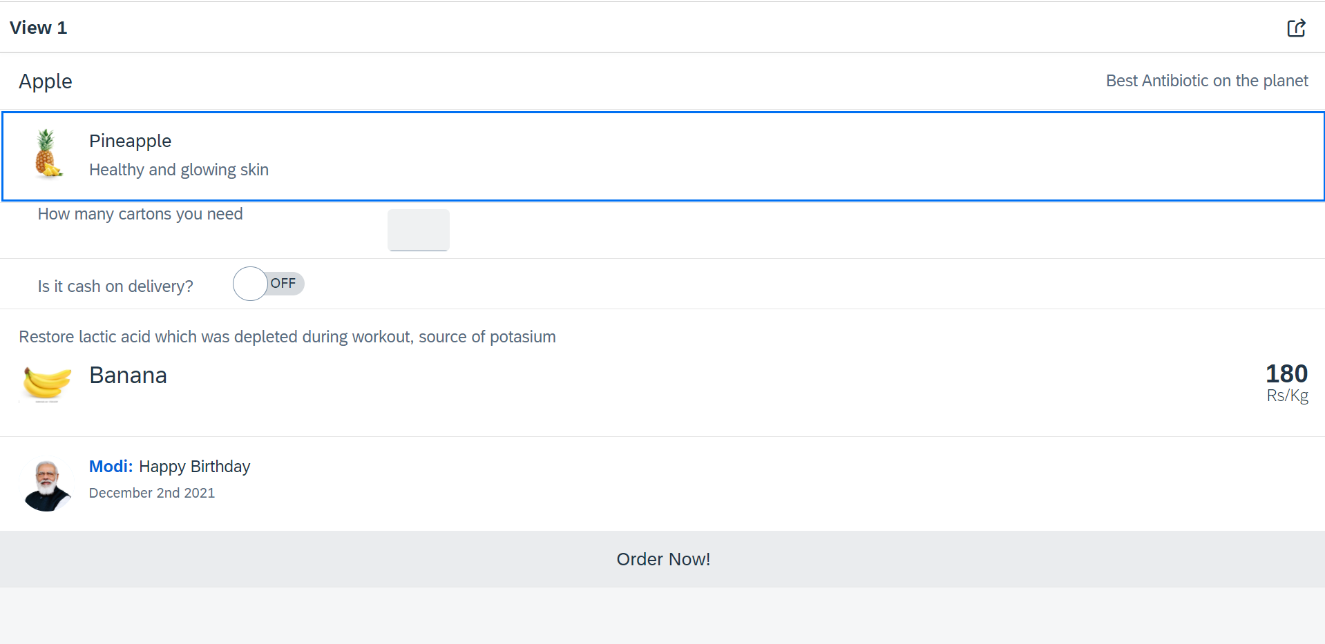
Hands – on: List Controls in UI5
Now we will add some basics list controls in the View1 of our application.
Code Links:
View1.view.xml

Slide 5
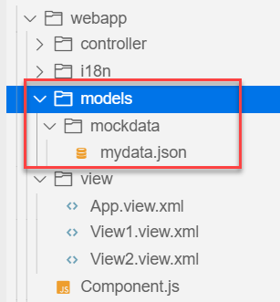
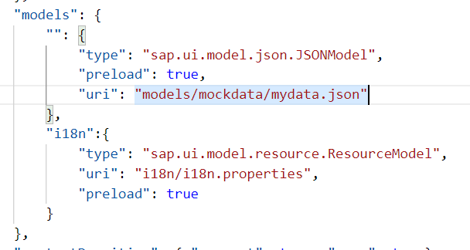
Hands – on: Models in manifest.json
Now we want to bind our list control to a model to show the multiple records using the list control.
For this first we need a file with some demo data related to the fruits, so we have created a file which has three entity sets:
fruits – name, color, type (neutral, citrus, alkaline),price, healthBenefit, unit, status (available, discontinued, out of stock), image (url from google) – 20
cities – name, state, famousFor, population – 10
supplier – name, city, country, contactPerson, phone, email, sinceWhen – 10
Now we will create a models folder in the webapp and in the models folder we will create a folder named mockdata, we will put our json file in this folder.
Code Link:
manifest.json
mydata.json
View1.view.xml

Slide 6
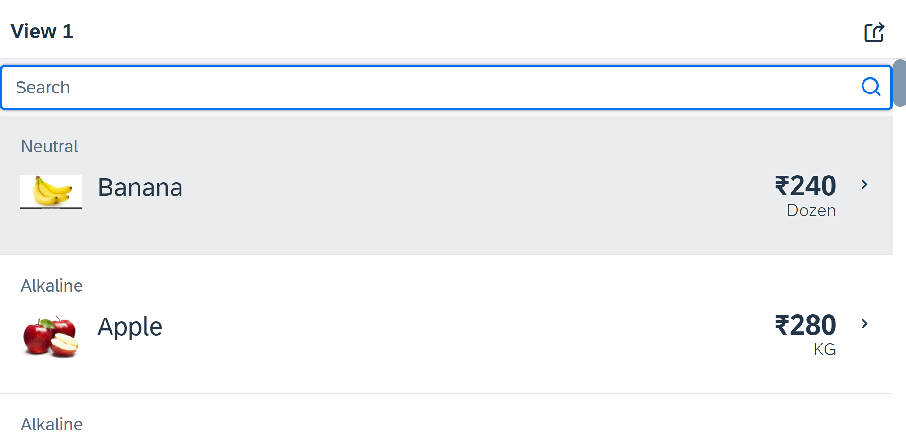
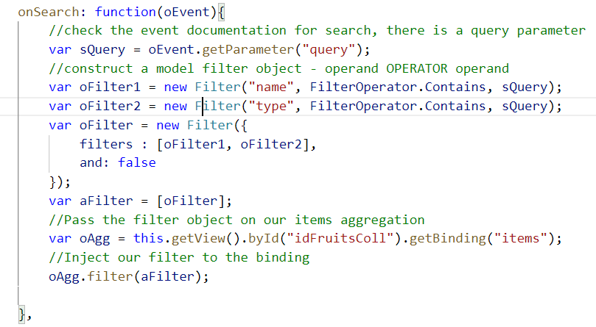
Hands – on: Search Functionality
Nowadays we come across many web pages that provide data in the form of lists or tables. These lists are enabled with search functionality, i.e., as the user types in into the search field and press enter then the data in the list is filtered according to the value in search field.
Code Link:
View1.view.xml
View1.controller.js

Slide 7
List Modes
The mode property defines the appearance of the left area of a list item.
Lists have properties and events and they contain list items that inherit from sap.m.ListItemBase, which provides navigation, selection and event features.
Delete
SingleSelect
01
04
only one list item can be deleted via provided delete button
Right-positioned single selection mode (only one list item can be selected).
01
04
MultiSelect
You can edit this text
SingleSelectLeft
02
05
02
more than one list item can be selected
05
Left-positioned single selection mode (only one list item can be selected).
03
06
None
03
06
SingleSelectMaster
no selection
Selected item is highlighted but no selection control is visible (only one list item can be selected).

Slide 8
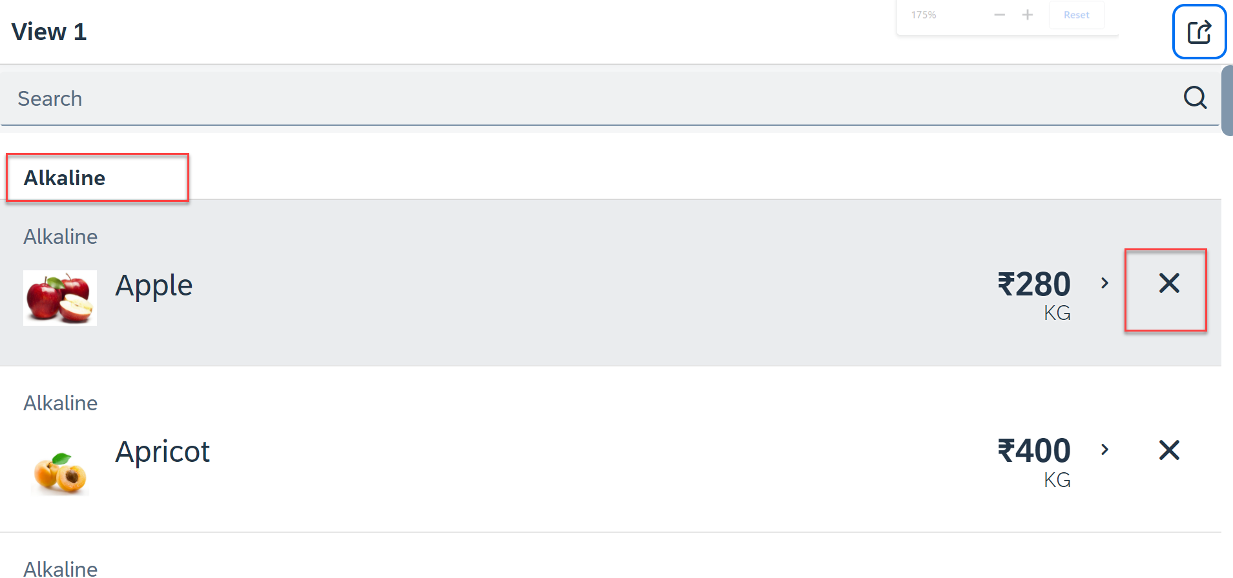
Hands – on: List modes and Grouping
Now we will look at the different type of List mode provided by the UI5.
Along with that we will Implement the Press event, Selection change and Delete Event in the List Control.
Also we will Group the data according to the type of Fruit.
Code Link:
View1.view.xml
View1.controller.js

Slide 9
Title
Content

Slide 10
Title
Content

Slide 11
Title
Content

Slide 12
Title
Content

Slide 13
Title
Content

Slide 14

End of Day 10

Slide 15

Questions

Slide 16

Anubhav Oberoy

Slide 17


We’re committed to empower you to be
Most Desirable Resource
through powerful training solutions.
We build the workforce of the future.
250+
Corporate Clients
30,000+
Learners Trained
25000+
Learners Placed
FREE WEBINARS
Sign up for free webinars with industry experts every fortnight!
Enroll Now!
Contact us today!
https://anubhavtrainings.com/

Slide 18




More from AnubhavTrainings.com

Slide 19
Title
Content

